Slide 1
Postal Service Health Benefits System (PSHBS) Full Historical Carrier Enrollment Reconciliation Strategy
July 24, 2025

Slide 2
Full Historical Carrier Enrollment Reconciliation Problem
Currently, End-Dated Coverage from prior months falls off the PSHBS Preaudit and Carrier MENR files making it impossible to reconcile enrollments for the full plan year.
While the Deloitte team can retain end-dated coverage from prior months on the PSHBS Preaudit, we cannot expect all PSHB Carriers to make the same adjustment for the MENR in the same timeframe.
Since all prior Carrier MENR records are stored in PSHBS this strategy outlines how MENR end-dated coverage from prior months can be retained so that full historical Carrier Enrollment Reconciliation can be achieved.

Slide 3
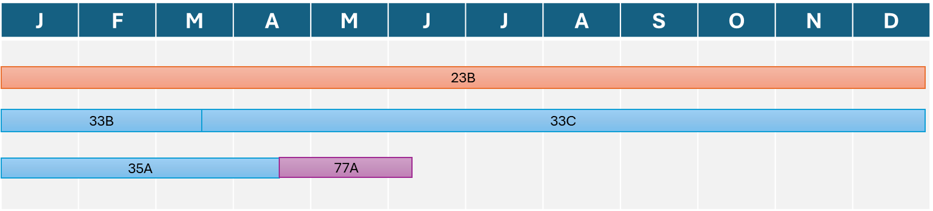

End-Dated Coverage from prior months falls off the Carrier MENR
PSHBS View of Enrollment Coverage Spans
Member 1 enrolled in APWU (23B) 1/1/2025 – 12/31/2025
Member 2 enrolled in BCBS (33B) 1/1/2025 – 3/15/2025 then BCBS (33C) 3/16/2025-12/31/2025 (plan change)
Member 3 enrolled in BCBS (33A) 1/1/2025 – 4/18/2025 then NALC (77A) 4/19/2025-6/10/2025 (plan change then termination)
August MENR View of Enrollment Coverage Spans
Member 1 enrolled in APWU (23B) 1/1/2025 – 12/31/2025
Member 2 enrolled in BCBS (33C) 3/16/2025-12/31/2025, no 33B coverage span reported cannot be reconciled
No Member 3 enrollment coverage reported cannot be reconciled

Slide 4
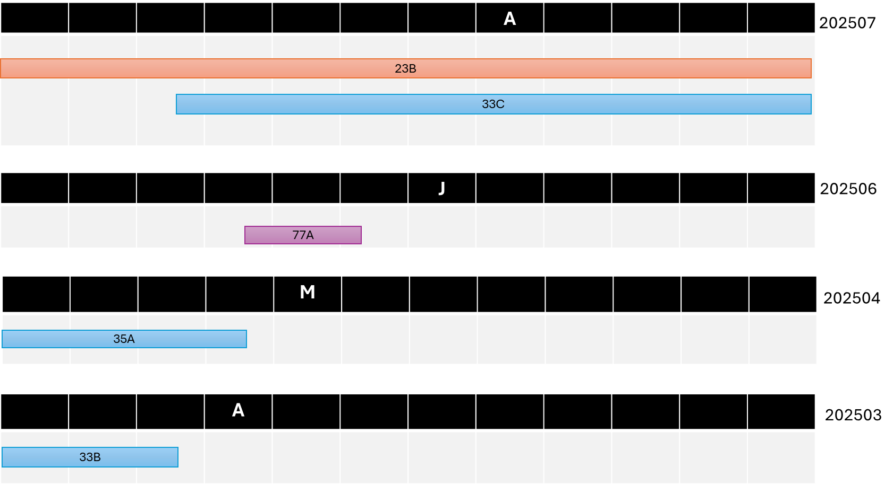
A ‘Full’ MENR is needed to compare against the ‘Full’ Preaudit. RCNO process needs to pull in MENR records from prior recon_months in int_recon_menr_in_mly_stg

Slide 5
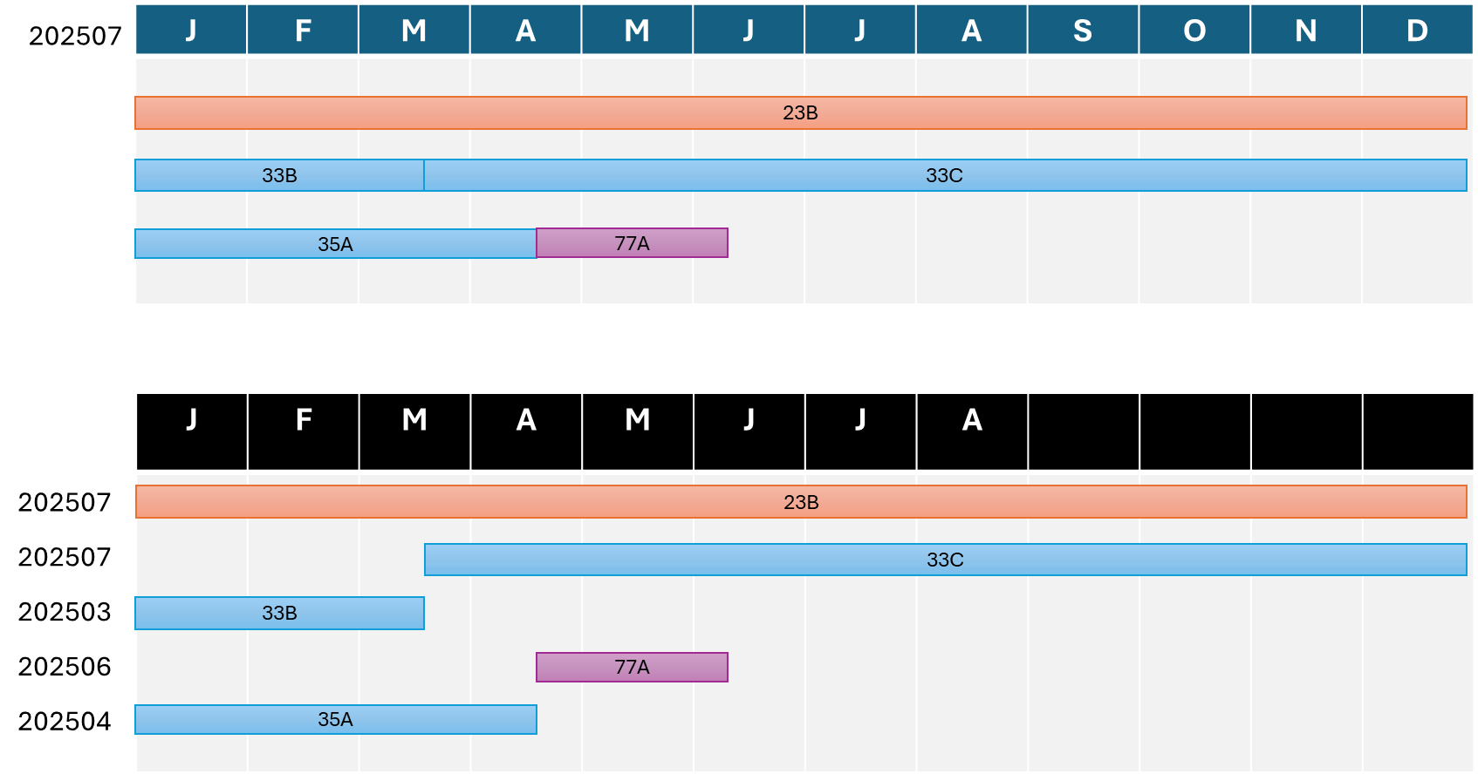
The ‘Full’ Preaudt can then be compared with the ‘Full’ MENR with PSHBS and MENR recon_month added to the RCNO to identify MENR records taken from prior MENR files
PSHBS_Recon_Month added to RCNO
Member 1
Member 2
Member 3
MENR_Recon_Month added to RCNO
Member 1
Member 2
Member 3

Slide 6
Steps to produce ‘Full’ MENR
Get latest recon_month and its first day as date
Calculate the start of that latest month as a date
Get all latest-month records
Get prior-month records where cov_end_dt < start of latest month, then deduplicate
Final result, combine all latest-month MENR records with all deduplicated prior-month MENR records
-- Step 1: Get latest recon_month and its first day as date
WITH latest_month_cte AS (
SELECT MAX(recon_month) AS latest_recon_month
FROM prod_pshbs_prd.interfaces.int_recon_menr_in_mly_stg
), -- Step 2: Calculate the start of that latest month as a date
latest_month_date AS (
SELECT latest_recon_month,
TO_DATE(CONCAT(SUBSTRING(latest_recon_month, 1, 4), '-', SUBSTRING(latest_recon_month, 5, 2), '-01')) AS latest_month_start
FROM latest_month_cte
), -- Step 3: Get all latest-month records
latest_records AS (
SELECT t.*
FROM prod_pshbs_prd.interfaces.int_recon_menr_in_mly_stg t
JOIN latest_month_cte lm ON t.recon_month = lm.latest_recon_month
),

Slide 7
Steps to produce ‘Full’ MENR
-- Step 4: Get prior-month records where cov_end_dt < start of latest month, then deduplicate
prior_records_deduped AS (
SELECT -- list all columns explicitly to avoid row_num in final result
seq_num, subscr_id, mbr_rlshp_cd, pat_cd, mbr_id, last_na, first_na, middle_na, sfx_nm, birth_dt, sex_cd, mbr_ssn_num, subscr_ssn_num, event_cd, trans_cd, rec_prcss_dt, plan_cd, cov_start_dt, elg_eff_cd, cov_end_dt, extn_cov_end_dt, term_rsn_cd, death_dt, bad_addr_ind, addr_prcss_dt, addr_ln1_nm, addr_ln2_nm, city_nm, state_cd, zip_cd, cntry_cd, subscr_empl_stat_cd, annuitant_num, subscr_rtr_dt, subscr_rempl_dt, mcare_flg, mcare_last_upd_dt, mcare_cvrg_cd, mcare_id, pyrl_ofc_num, dec_ann_ssn, pseudo_ssn, alt_pyrl_off_id, file_process_dt, carrier_name, mul_match_sw, snap_rec_seq_num, appln_id, logical_id, batch_run_id, person_mbrsh_id, processing_status, error_cd, comments, created_by, created_dt, updated_by, updated_dt, initial_record_id, job_execution_id, source_file_name, recon_month, phone_num, email, extnd_cov_end_dt, addr_ln3_nm
FROM (
SELECT t.*,
ROW_NUMBER() OVER (
PARTITION BY carrier_name, subscr_id, mbr_id, plan_cd
ORDER BY recon_month DESC
) AS row_num
FROM prod_pshbs_prd.interfaces.int_recon_menr_in_mly_stg t
JOIN latest_month_date lm
ON t.recon_month < lm.latest_recon_month
AND t.cov_end_dt < lm.latest_month_start
) ranked
WHERE row_num = 1
) -- Final result
SELECT * FROM latest_records
UNION ALL
SELECT * FROM prior_records_deduped
Get latest recon_month and its first day as date
Calculate the start of that latest month as a date
Get all latest-month records
Get prior-month records where cov_end_dt < start of latest month, then deduplicate
Final result, combine all latest-month MENR records with all deduplicated prior-month MENR records
Latest MENR plus prior MENR End Dated records - Databricks

Slide 8



